Slide 1
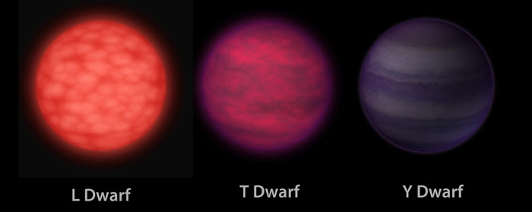
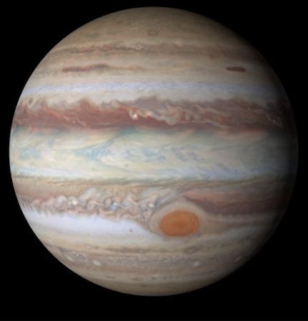


Mid-Infrared Observations of a Brown Dwarf Binary Around a Sun-Like Star
Rebekah Boisvert
The University of Arizona
Mentor: Dr. Brittany Miles
Steward Observatory
April 18th, 2026
Arizona NASA Space Grant Statewide Consortium

Slide 2
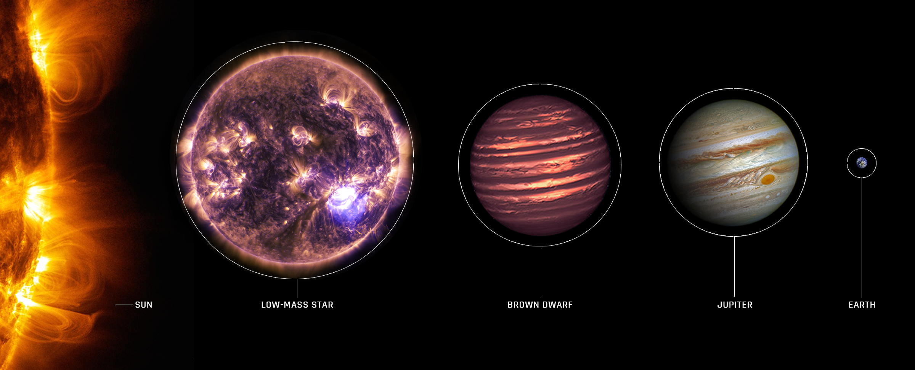
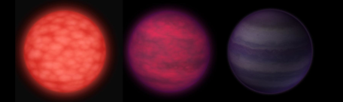
What Is a Brown Dwarf?
2
Too small to ignite hydrogen fusion in core
Large temperature range
Cold enough for molecules
Cooling affected by clouds in atmosphere
Credits: NASA
3000K 250K
2026 Arizona NASA Space Grant Statewide Student Consortium
rebekahboisvert@arizona.edu

Slide 3
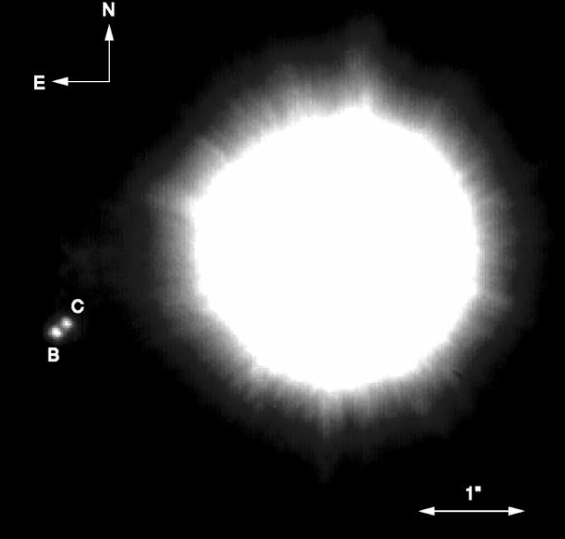
The System – HD 130948
3
System of a two brown dwarfs co-orbiting a sun-like star
.
Binary is about 45AU from the host star
b
Why This System?
Benchmark system, we know mass and age, good for testing theory
HD 130948 A
C
Distance of Neptune Orbit
Discovery image from Potter et al. (2002)
2026 Arizona NASA Space Grant Statewide Student Consortium
rebekahboisvert@arizona.edu

Slide 4
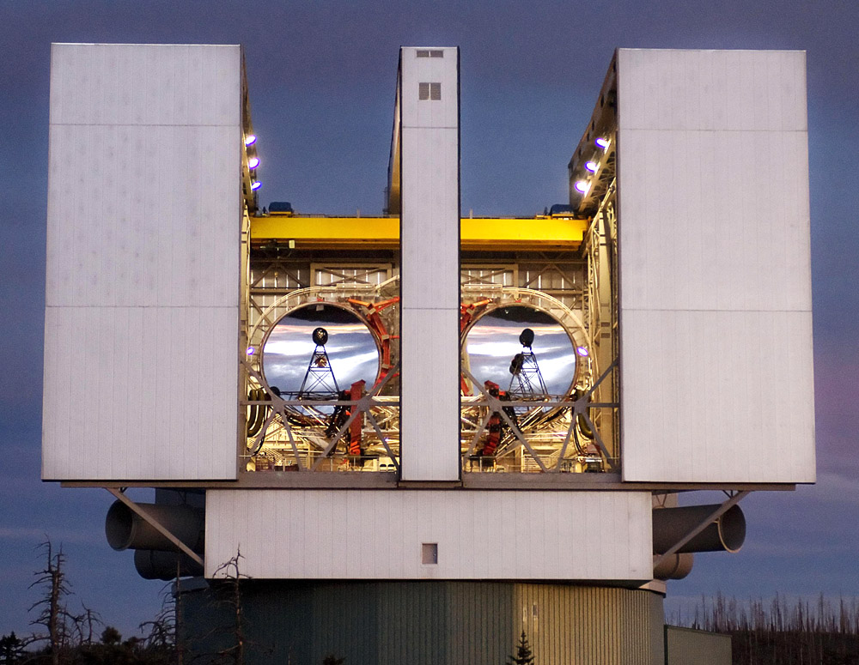
Observations
4
Taken with the Large Binocular Telescope using only one mirror
.
LMIRcam (LBT Mid-InfraRed Camera)
.
Previously observed up to a 4.1-micron wavelength
.
New Images in M-band (4.5 microns)
Credits: David S. Steele/AP
2026 Arizona Space Grant Statewide Student Consortium
rebekahboisvert@arizona.edu

Slide 5
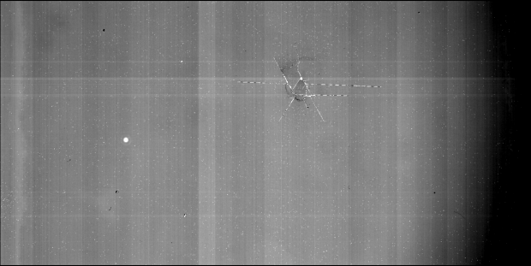
Reducing Data – Raw Data
5
Raw data is impacted by various sources of noise including thermal, background, and detector noise
HD 130948A
Channel Noise/ Striping Pattern
2026 Arizona Space Grant Statewide Student Consortium
rebekahboisvert@arizona.edu

Slide 6
Reducing Data – Raw Data
6
Raw data is impacted by various sources of noise including thermal, background, and detector noise
HD 130948 A
Brown Dwarf Binary?
Channel Noise/ Striping Pattern
2026 Arizona NASA Space Grant Statewide Student Consortium
rebekahboisvert@arizona.edu

Slide 7
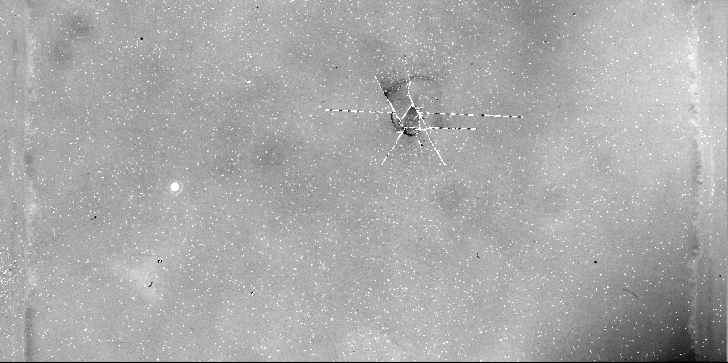
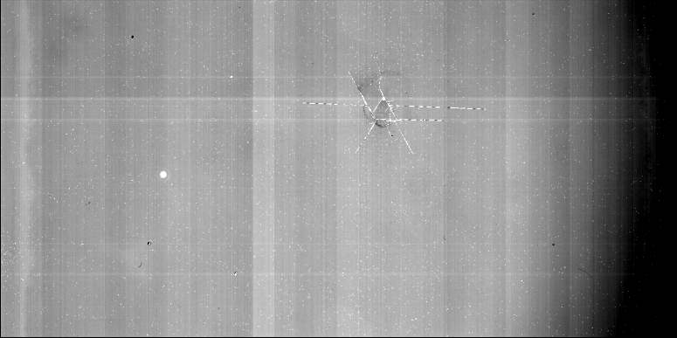


Reducing Data – Nod Subtraction
7
To remove background noise, we perform nod subtraction
. .
Subtract a shifted Image B from Image A
Image A
Image B
-
Brown Dwarf Binary?
2026 Arizona NASA Space Grant Statewide Student Consortium
rebekahboisvert@arizona.edu

Slide 8
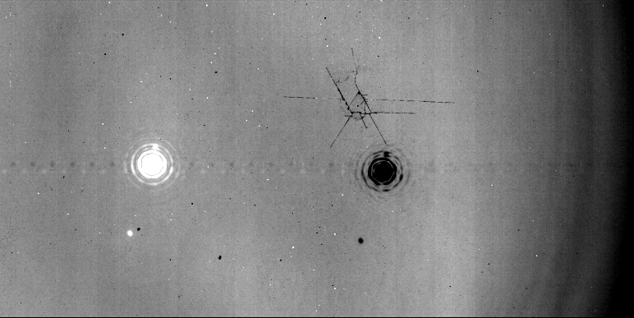
Reducing Data – De-striping
8
After nod subtraction, the binary is visible
.
We have positive and negative images of system
.
Only detector channel noise left
HD 130948 A
Brown Dwarf Binary!
Channel Noise/ Striping Pattern
2026 Arizona NASA Space Grant Statewide Student Consortium
rebekahboisvert@arizona.edu

Slide 9
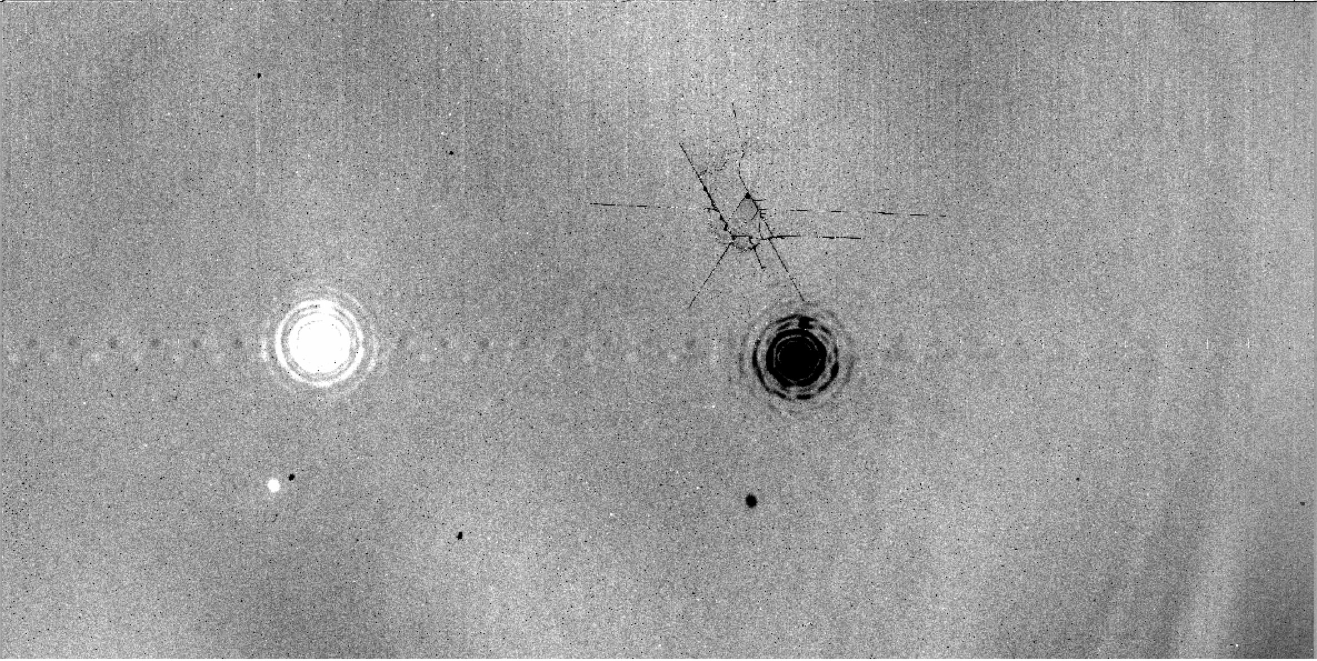
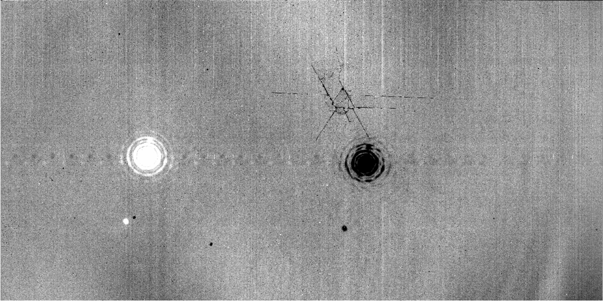
Reduced Image of HD 130948 System
9
Most noise has been removed
.
We will focus on the left side of this image for now
Brown Dwarf Binary
2026 Arizona NASA Space Grant Statewide Student Consortium
rebekahboisvert@arizona.edu

Slide 10
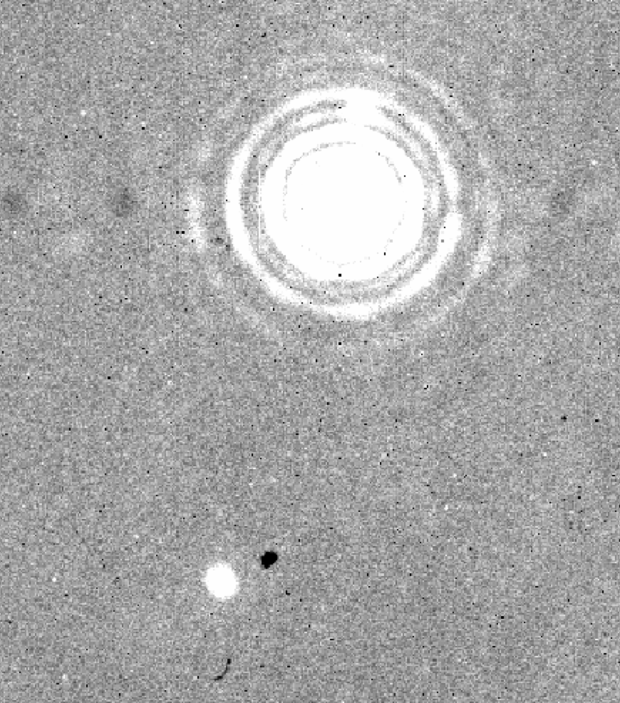
Results - Brown Dwarf Flux
10
Use host star to calibrate pixel value to physical flux units
Use aperture photometry to estimate brown dwarf flux
Brown Dwarfs ~3 orders of magnitude dimmer than the host star
HD 130948 A
Object | Brightness (Jy)
HD 130948 A | 3.36 Jy
HD 130948 B+C | 0.00985 Jy
HD 130948 BC
2026 Arizona NASA Space Grant Statewide Student Consortium
rebekahboisvert@arizona.edu

Slide 11
Results - Brown Dwarf Flux
11
Use host star to calibrate pixel value to physical flux units
Use aperture photometry to estimate brown dwarf flux
Brown Dwarfs ~3 orders of magnitude dimmer than the host star
HD 130948 A
v
Object | Brightness (Jy)
HD 130948 A | 3.36 Jy
HD 130948 B+C | 0.00985 Jy
HD 130948 BC
2026 Arizona NASA Space Grant Statewide Student Consortium
rebekahboisvert@arizona.edu

Slide 12
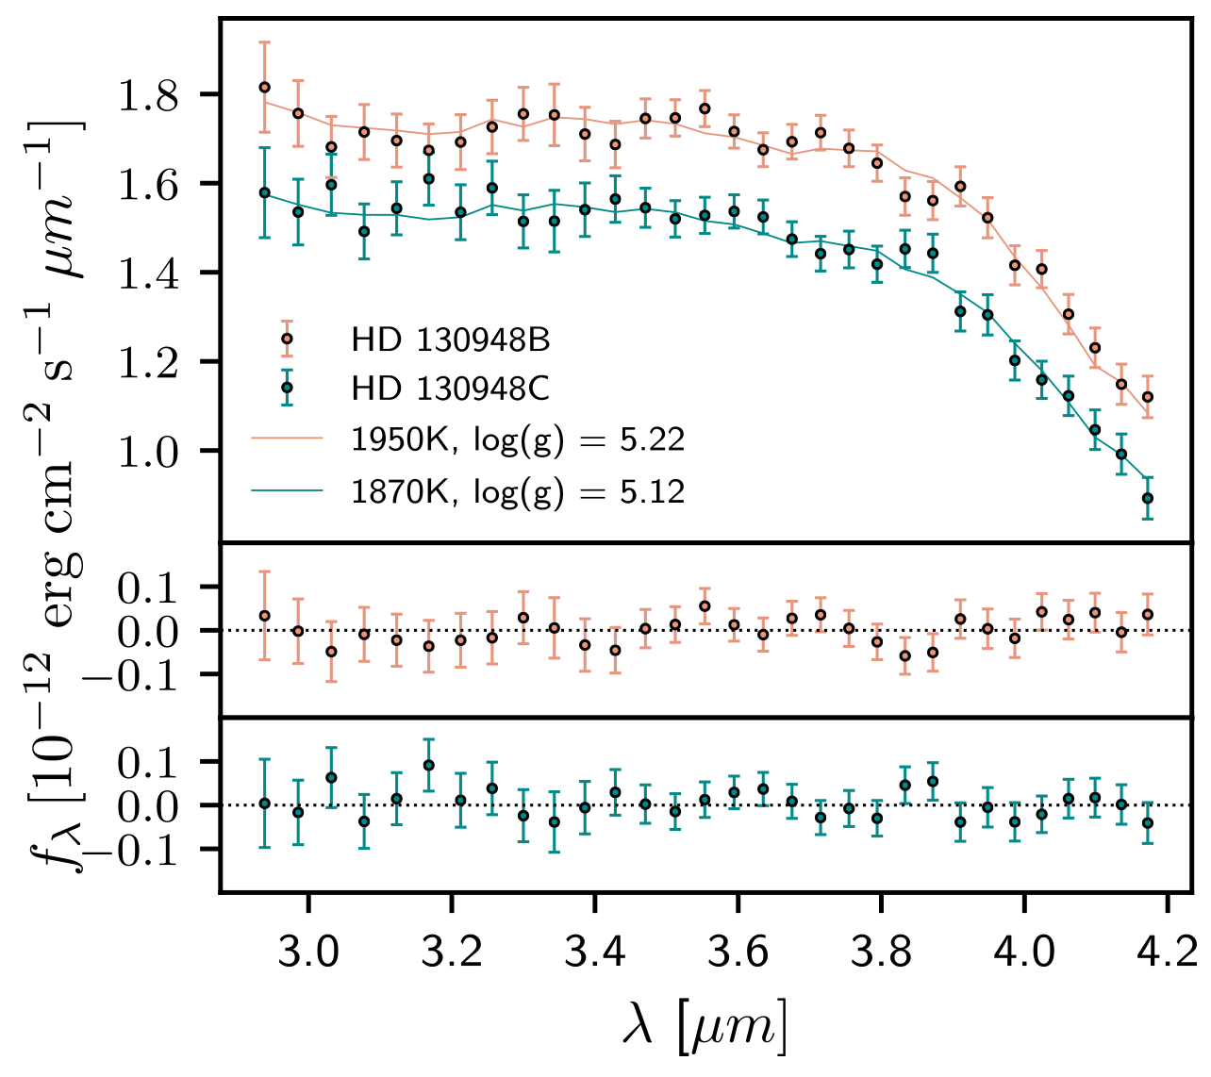
Results - Brown Dwarf Atmosphere
12
Spectra of Each Brown Dwarf
Given this flux, we can add it to past observations
Using spectra and new photometry, we compare to atmospheric models
Flux (erg/s/cm^2/micron)
?
4.4
4.6
Wavelength (microns)
Figure adapted from Briesemeister et al. (2019)
2026 Arizona NASA Space Grant Statewide Student Consortium
rebekahboisvert@arizona.edu

Slide 13
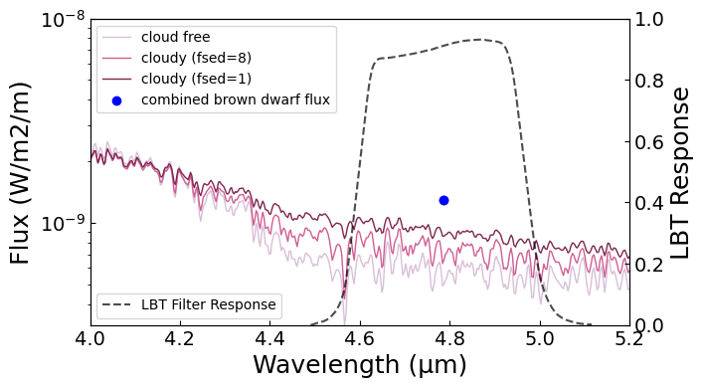
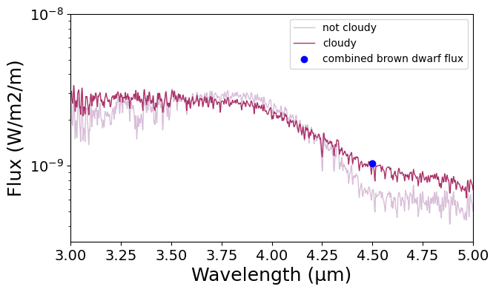
Results - Brown Dwarf Atmosphere
13
Combined Flux Plotted on Atmospheric Model
We have combined brown dwarf flux
Current data suggests both brown dwarfs are cloudy
Flux (W/m^2/m)
2000K
Wavelength (microns)
Preliminary results
2026 Arizona NASA Space Grant Statewide Student Consortium
rebekahboisvert@arizona.edu

Slide 14
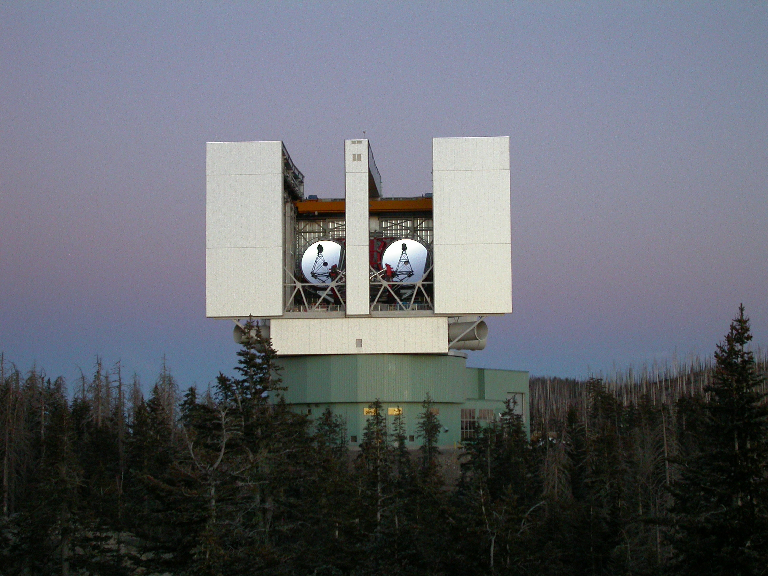
Future Work
14
.
Reduce data taken with both LBT mirrors
.
Point Spread Function (PSF) fitting
.
We can use this system to test evolutionary models, including the impact of clouds
Credits: NASA/JPL-Caltech
2026 Arizona NASA Space Grant Statewide Student Consortium
rebekahboisvert@arizona.edu

Slide 15
THANK YOU!
2026 Arizona NASA Space Grant Statewide Student Consortium
rebekahboisvert@arizona.edu

